Slide 1


Week 6: Other-repair and resonance
Ryan Ka Yau Lai
University of California, Santa Barbara

Slide 2
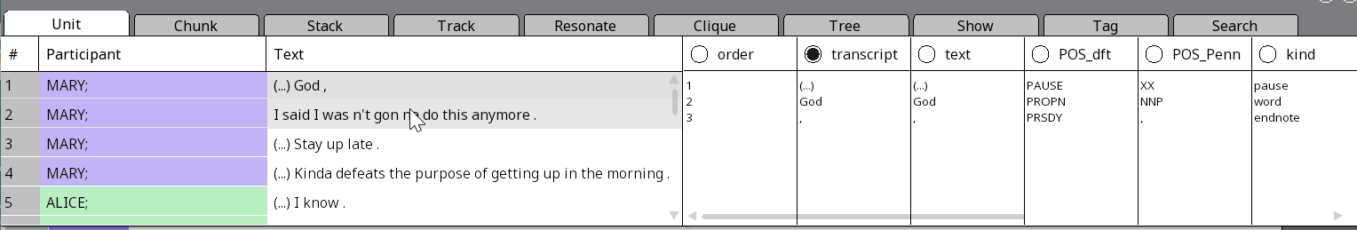
While we’re waiting …
Open SBC007 on Rezonator
Preferably a previously saved version
Open the audio file
Change active display to the transcript field
Note today’s codeword and question on the board
Give me your availability for additional office hours: https://www.when2meet.com/?20029191-hfj1J
Shameless plug: You can still enroll in LING 194 Visualising language in conversational interactions, which I teach in summer!
Apply for a scholarship here: https://ucsb.my.site.com/success/s/apply-for-summer-scholarship

Slide 3

Question for today
Find an example of resonance from a Q&A or repair sequence from any text you have worked on before, identify the frame and focal resonances, and justify your answer.
[If possible, send me a screenshot, with resonance links if you are able to make them.]

Slide 4
After today, you will be able to …
Describe
Describe the three steps in the resonance cycle
Distinguish
Distinguish between frame and focal resonance
Annotate
Annotate resonance in Rezonator
Identify
Identify cases of other-repair
Understand
Expectations for the mini-paper
Clarify
Common mistakes and misconceptions regarding repair

Slide 5
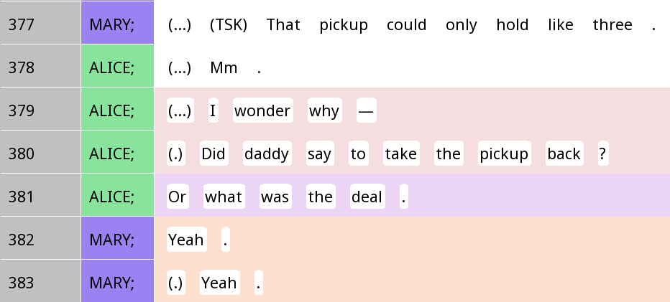
Describing cues for a Q&A pair: Clarifications
Grammatical cue: Question inversion – ‘Did daddy say’ instead of ‘Daddy said’ (or ‘Daddy did say’)
Prosodic cue: Rising intonation
Pragmatic cue: This was uttered with respect to something that Mary knows about, but Alice does not
Pragmatic cue: Mary answers with a response token yeah, which is a common response format for polar questions

Slide 6
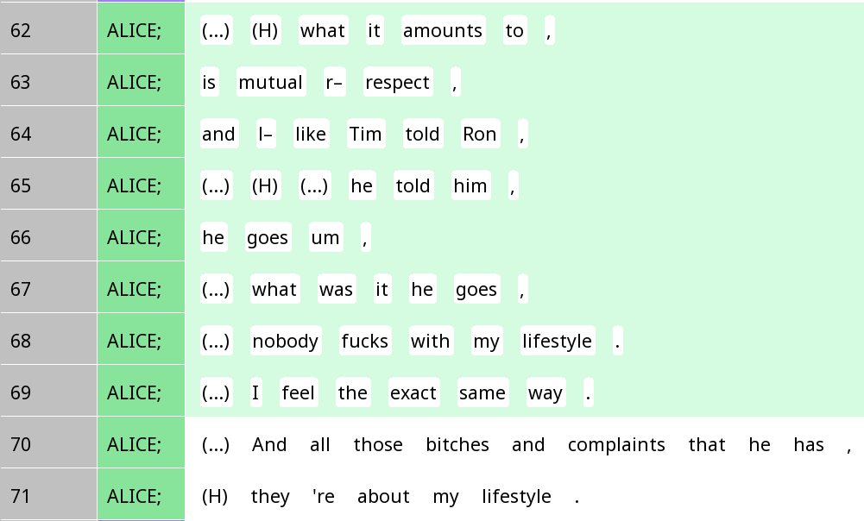
Describing cues for a non-Q&A pair: Clarifications
Grammatical cue: Question inversion – ‘was it’ instead of ‘it was’ – and a question word what
Prosodic cue: Continuing intonation, suggesting this line is part of a larger TCU instead of an action (question) in its own right
Pragmatic cue: This is an incident only Alice knows about, and Mary does not, so it wouldn’t make sense for Alice to ask Mary about it
Pragmatic cue: The ‘answer’ is provided by Alice herself, not Mary

Slide 7
Mini-paper 1
For the mini-paper, it is important that there is an overall point you want to make
Each of the content you introduce should be related back to that overall point
You should selectively incorporate questions from previous shows to support that overall point
Note that you need a separate discussion section
It should bring together all your points, but also distill insight by synthesising what you’ve learnt in class and readings in relation to what you’ve done in the rest of the paper
Please feel free to copy-paste content from the shows
But do address the comments and suggestions for improvement I gave in your shows, both inline comments and rubric comments

Slide 8
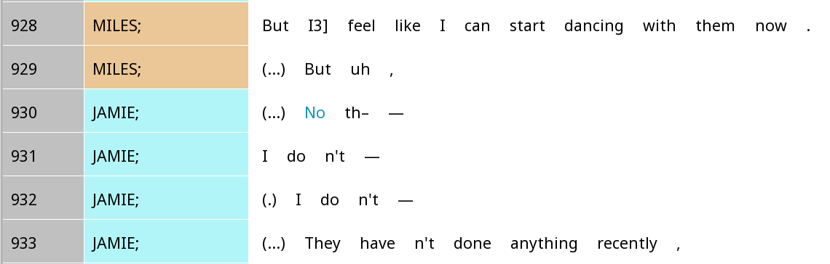
Clarifications on repair: Identifying repair
Not all kinds of disagreements or follow-up questions count as repair
When we say ‘trouble’ in listening or speaking, we don’t mean ‘Is the content of what the person said correct’?
Instead, we are thinking of, ‘Did the person successfully perform the conversational action they intended’?
Jamie is disagreeing with Miles, and Miles is probably wrong, but this is not repair, because it’s not about fixing problems with Miles’ performance of his intended social action

Slide 9
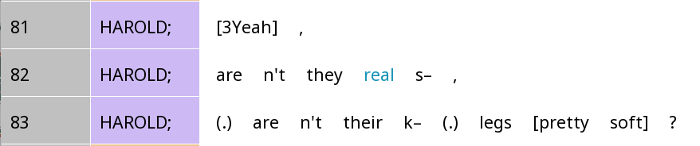
Clarifications on repair: Identifying the trouble source
In self-initiated self-repair, if a person cuts off themselves, the trouble source isn’t necessarily just what directly comes before the cut-off
In this example (which many of you cited), the trouble source should be they real or even just they
The s- part was actually ‘right’, as you can see in line 83 (soft); Harold was realising that the use of they was unclear and switched to their

Slide 10
Things to look out for (Show 3)
Self-initiated vs other-initiated repair
Is there an explicit word/phrase that initiates the repair? Or is it implicit (e.g. just by cutting yourself off)?
Is the trouble caused by overlap or inaudible sounds?
In the repair (completion) does the speaker start directly from the trouble source, or add a little bit of context before?
Grammatical, prosodic (e.g. cutting oneself off) & pragmatic cues for identifying trouble sources and repair initiations
Does the repair take place after a first pair part, after a second pair part, or neither? Does it take the form of insert or post expansion?

Slide 11
Repair vs trouble source
The trouble source is they real
But the repair starts earlier, to include aren’t

Slide 12
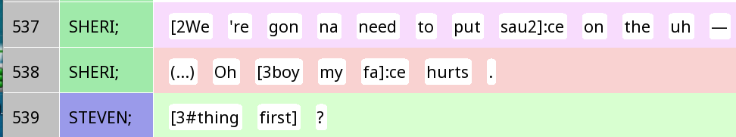
Self-initiated other-repair
Trouble source
Initiation
Completion

Slide 13
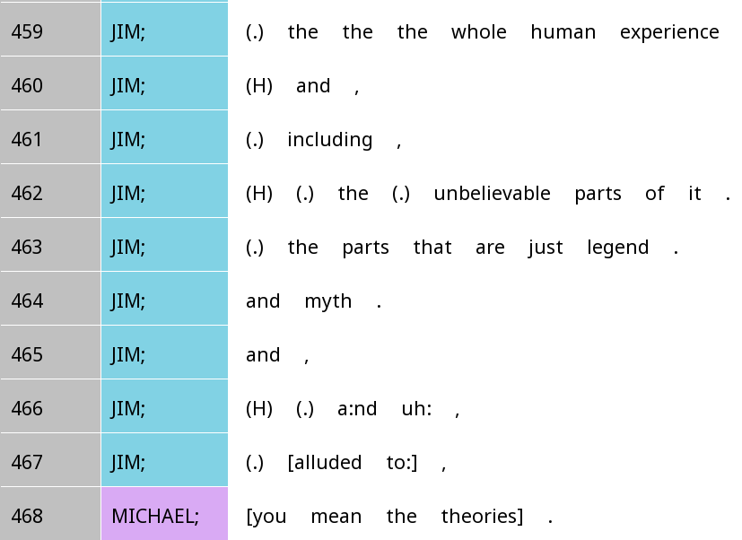
Other-initiated other-repair
Trouble source
Initiation
Completion

Slide 14

Dialogic resonance
Simply put: Repetition of linguistic signs from previous speaker
Psycholinguistic perspective (in the mind): Priming
Discourse perspective (in language use): Resonance

Slide 15
Resonance cycle
Priming
Reproduction
Resonance
Hearing a structure once activates that structure in your mind.
When producing language, you reproduce that structure in your own production.
By producing a new utterance with a similar structure, you resonate with the previous utterance.

Slide 16
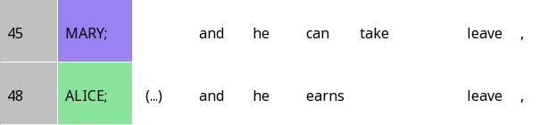

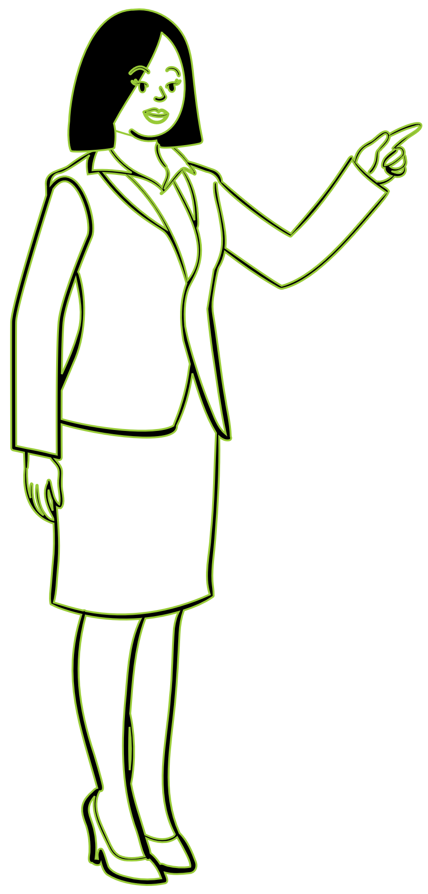
1. Priming
and he + verb + object

Slide 17
2. Reproduction

Slide 18
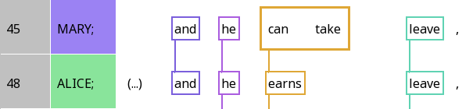
3. Resonance

Slide 19
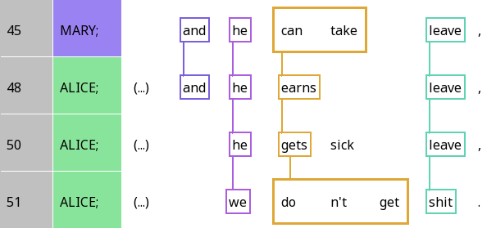
Frame resonance and focal resonance
Frame resonance: Resonance between identical elements or highly conventional correspondences

Slide 20
Frame resonance and focal resonance
Focal resonance: Resonance between elements that strongly contrast with the previous element, tell you ‘what’s new/different’

Slide 21
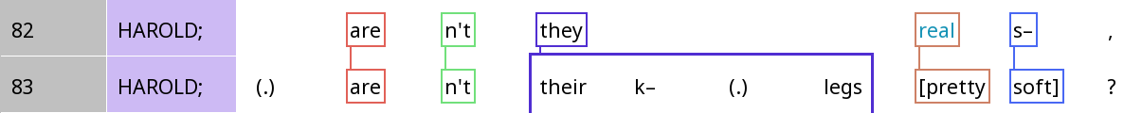
Repair and resonance
 | A | B | C | D | E
Harold | are | n’t | they | real | s-
Harold | are | n’t | their k- legs | real | s-
Question: Which columns are frame resonance and which are focal?

Slide 22





Annotating resonance in Rezonator

Slide 23
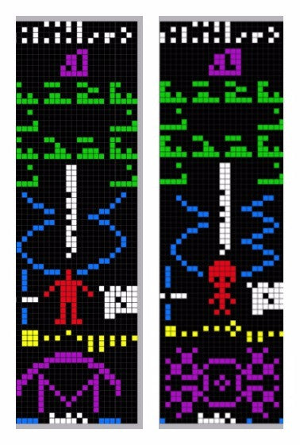
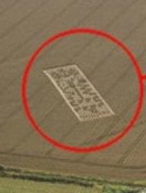

Slide 24
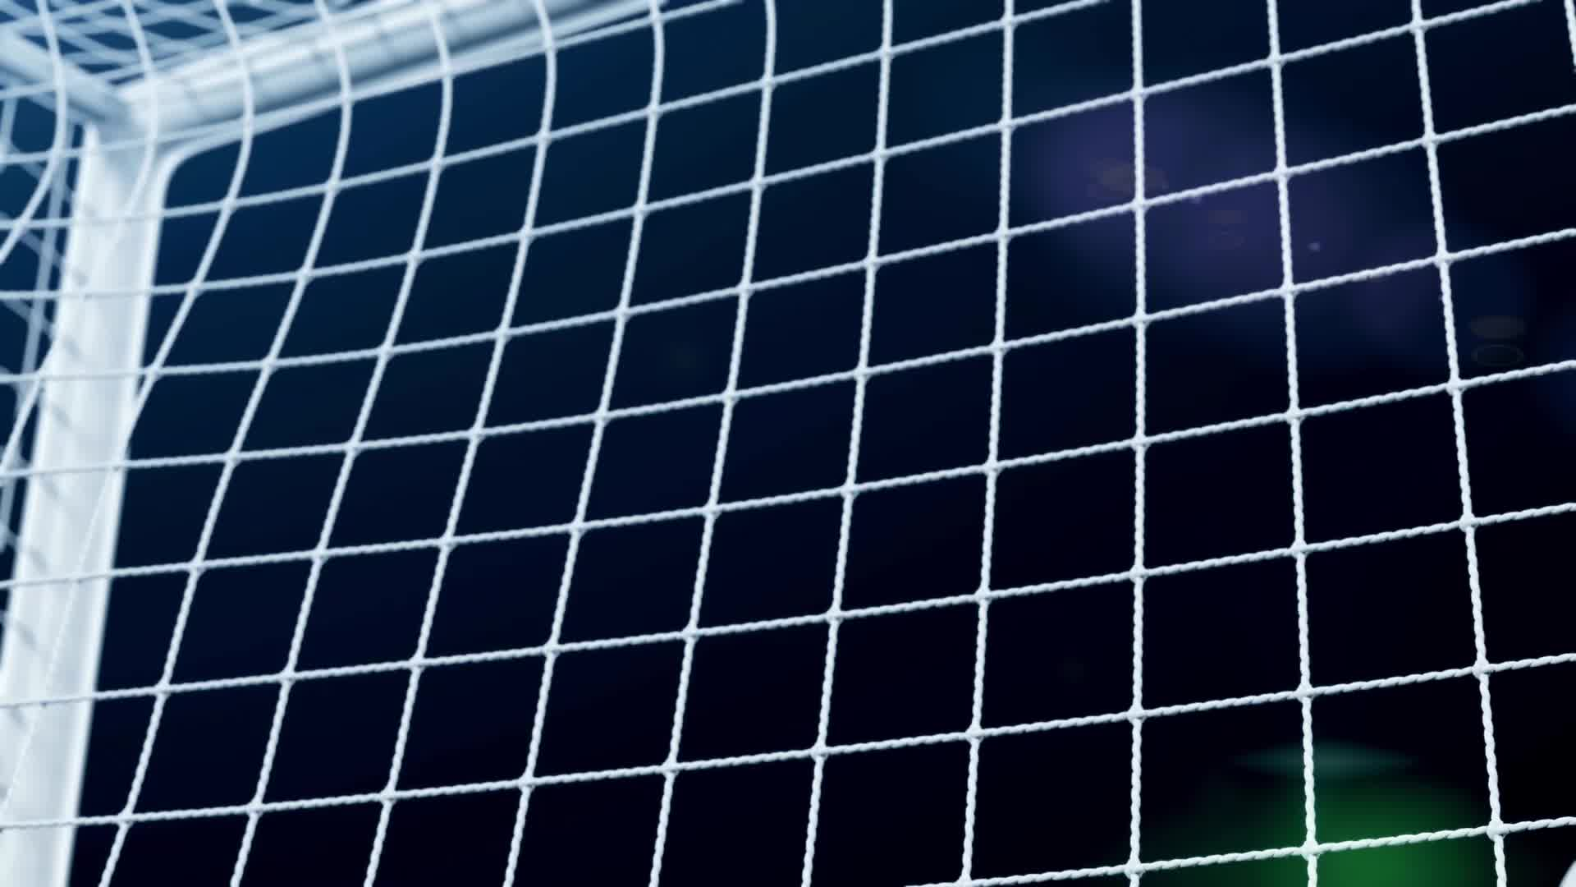
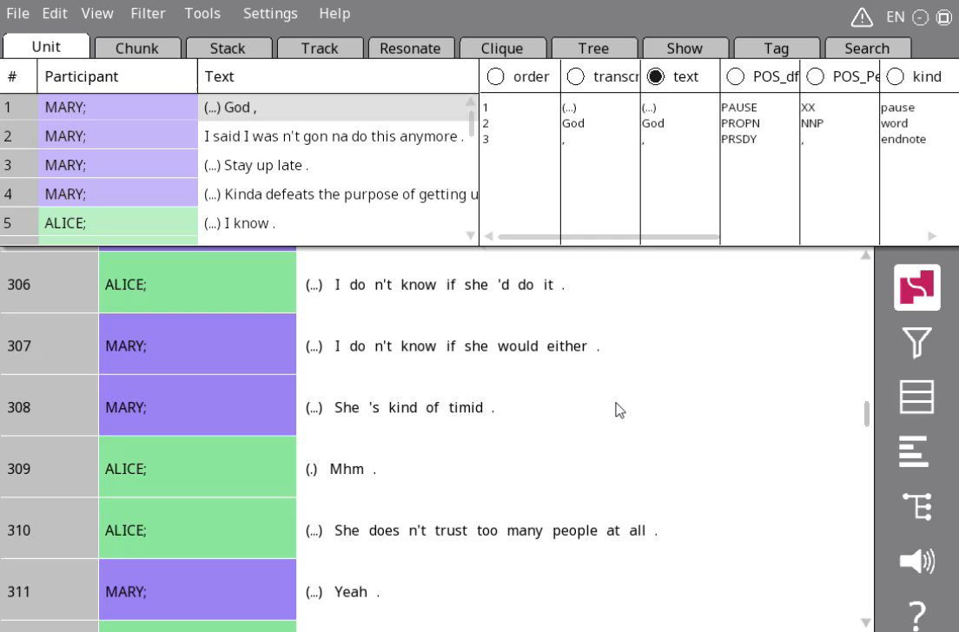


Resonance in Rezonator
Click the alignment button in the sidebar and choose the left-justified grid view
Also choose resonance mode

Slide 25
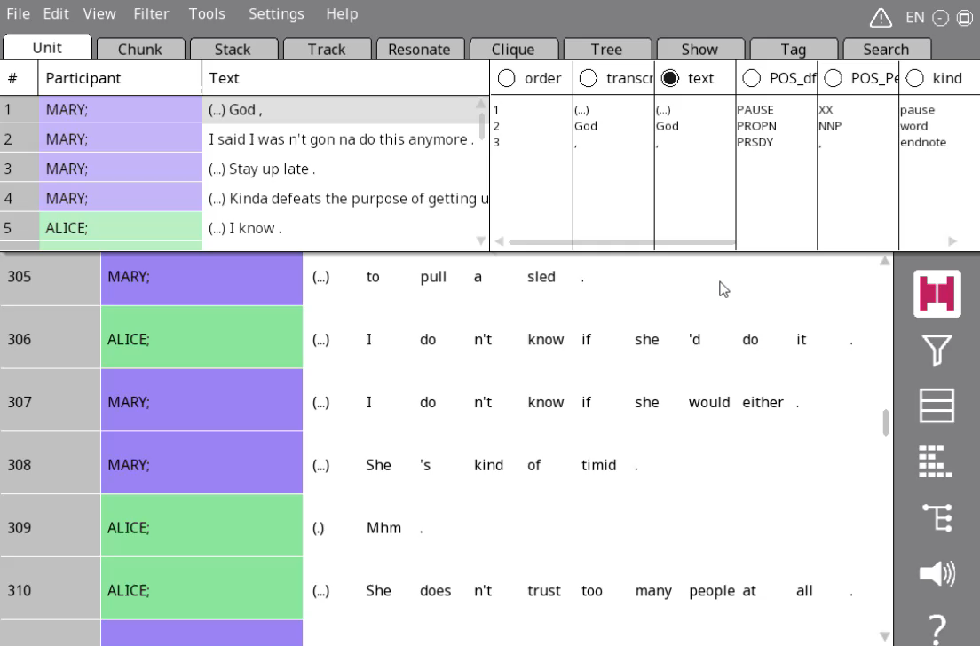
Annotating resonance – Method 1
Click on one word
Click on the resonating word
Go the Resonate tab and change names

Slide 26
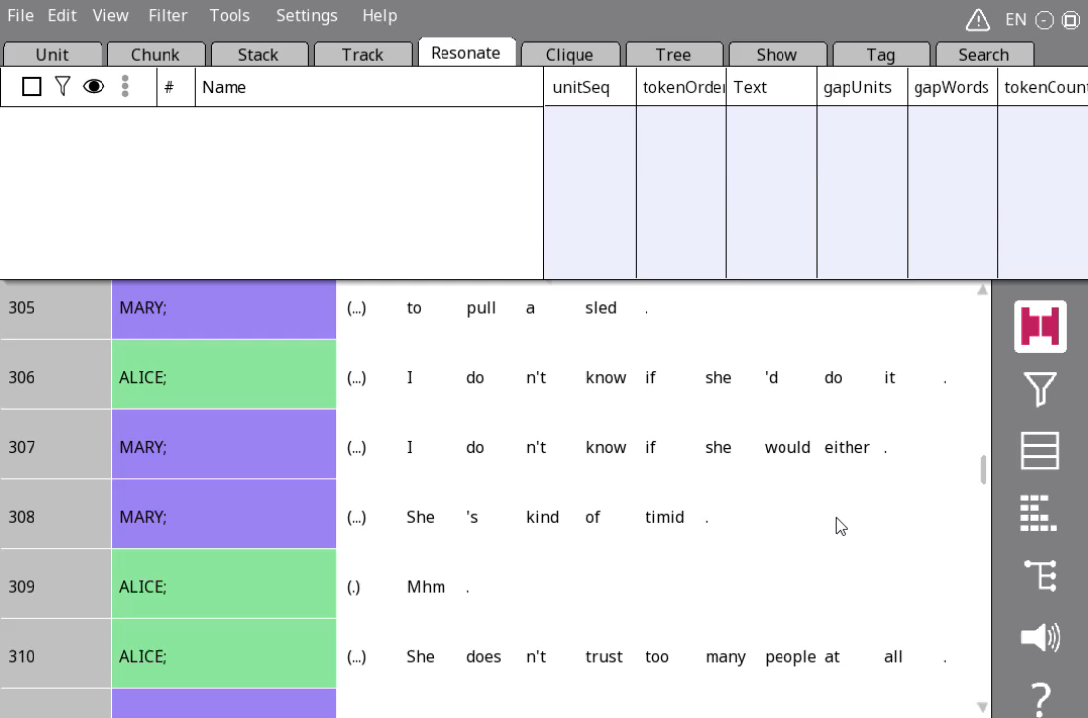
Annotating resonance – Method 2
Drag and drop on an area where the resonating words are already in the same column

Slide 27
Rezzes and resonances
Individual resonating words/chunks: Rezzes
Whole thing: resonance (chain)

Slide 28
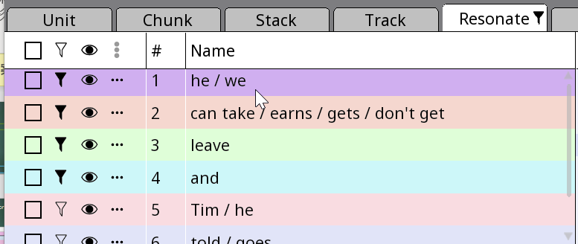
Show/hide vs filtering in Rezonator
Filtering: Show only some rows relevant to the resonance
Show/hide: Show/hide annotations, e.g. resonances

Slide 29


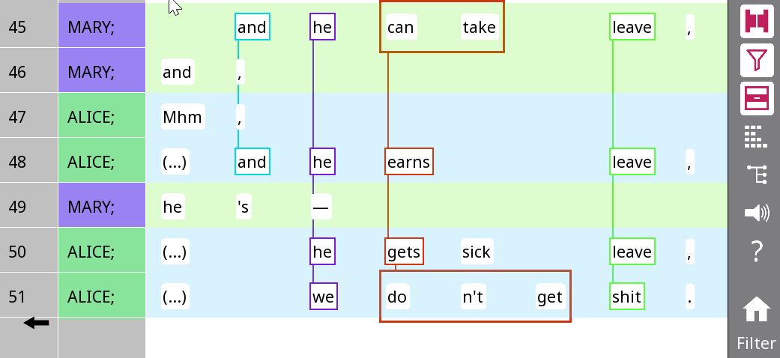
Filtering
Select filtering modes
Context below trail
Select resonances to see
Context between tracks
Context above trail
3. Filter by pressing the funnel button!

Slide 30
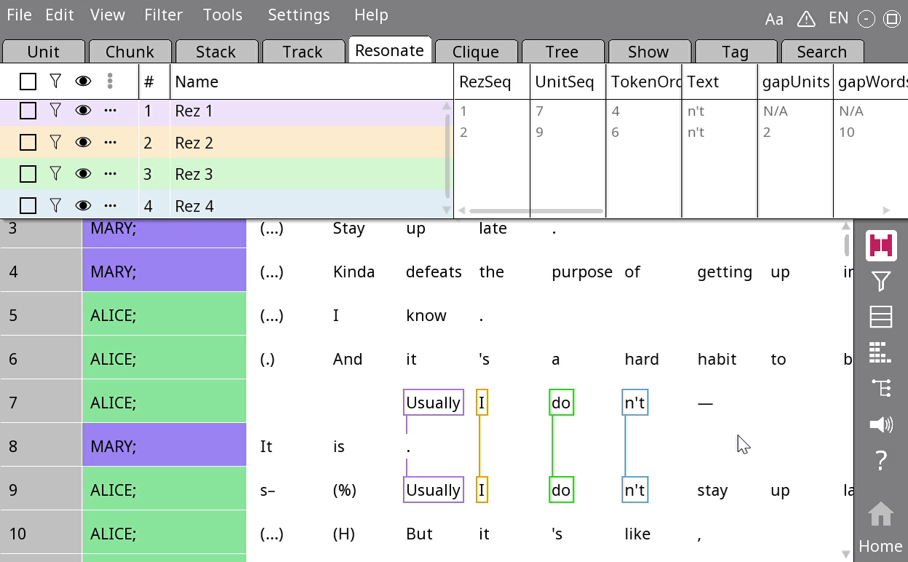
Some keyboard shortcuts
Quick pick: Type ‘p’ to filter on a specific resonance while it is in focus
Context: Type ‘c’ to quickly toggle between showing space between resonances, and not showing them

Slide 31

Your turn!
Take an example of repair or Q&A that you have found before in any text
Annotate the resonances in Rezonator
Identify the frame and focal resonances

Slide 32
Appendix slides

Slide 33
Frame resonance and focal resonance
Question: Which of the resonances between the third and fourth lines are frame resonances? Which are focal resonances? How does your answer differ from the relationships between the first three lines?

Slide 34
Frame resonance and focal resonance
Frame resonance
Focal resonance
Question: Which of the resonances between the third and fourth lines are frame resonances? Which are focal resonances? How does your answer differ from the relationships between the first three lines?

Slide 35
Diagraph
 | A | B | C | D | E
Mary | and | he | can take |  | leave
Alice | and | he | earns |  | leave
Alice |  | he | gets | sick | leave
Alice |  | we | don’t get |  | shit

Slide 36
Analysing analogies in focal resonance
 | B | C | E | C – interpretation
Mary | he | can take | leave | can – Possibility
Alice | he | earns | leave | -s – Habit
Alice | he | gets | leave | -s – Habit
Alice | we | don’t get | shit | don’t - Impossibility

Slide 37
Analysing analogies in focal resonance
 | B | C | E | E – interpretation
Mary | he | can take | leave | specific thing
Alice | he | earns | leave | specific thing
Alice | he | gets | leave | specific thing
Alice | we | don’t get | shit | anything

Slide 38
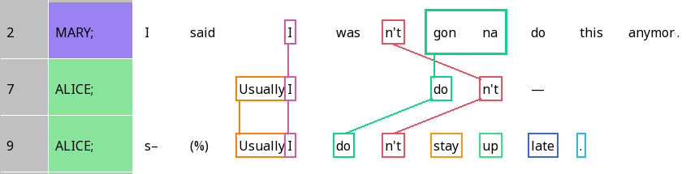
False starts in self-initiated repair
Self-resonance: Repeating structure to complete what you just said

Slide 39
Crossed resonance
When the order of resonating elements is different across different lines
Question: Can you think of a type of adjacency pair where crossed resonance would be common in English?

Slide 40
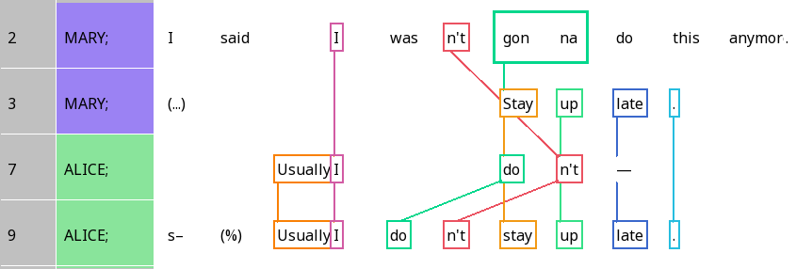
You can resonate with material from different lines!

Slide 41
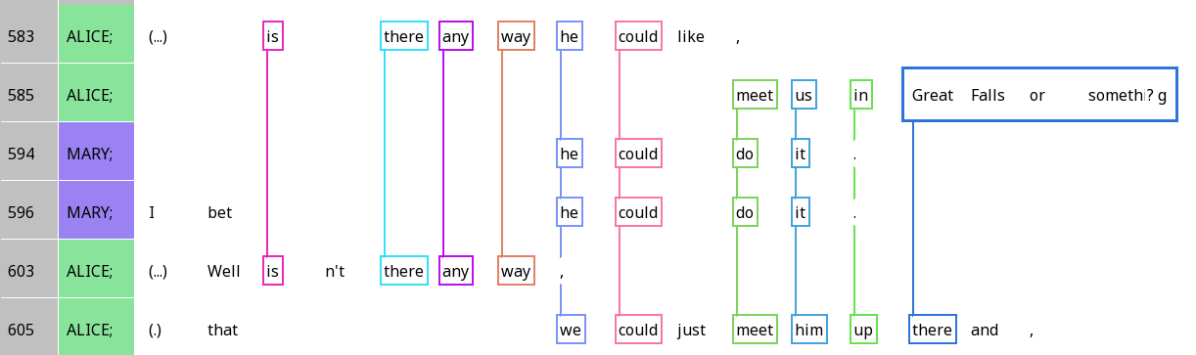
Resonance across IUs

